Slide 1
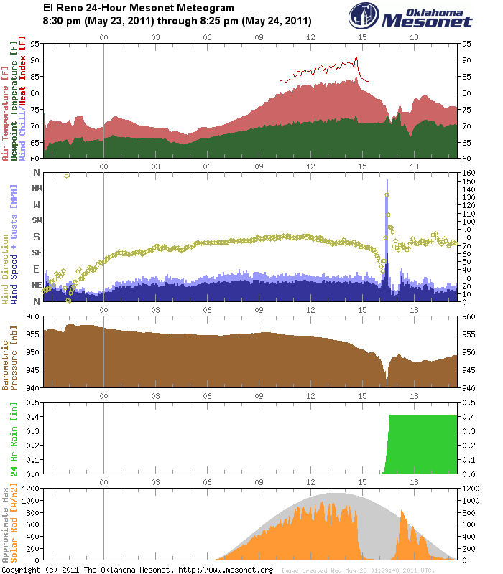
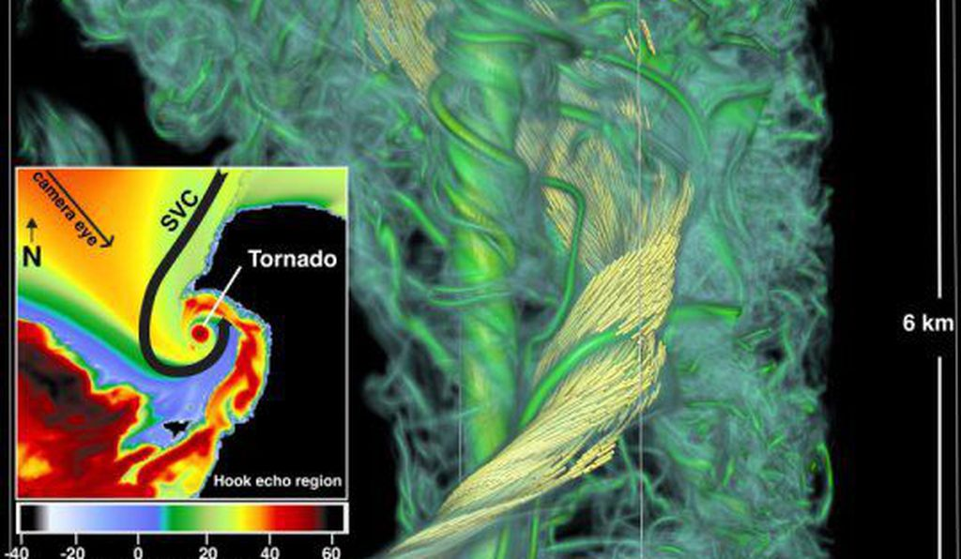
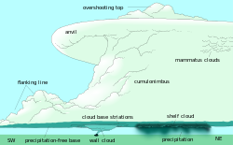
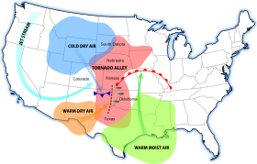
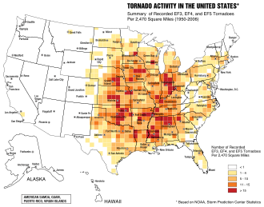
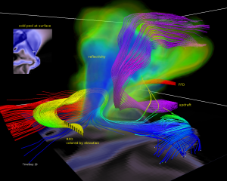
Investigating the events necessary for tornadoes to form
Introduction
Knowing how tornadoes form is a very important topic to research. Some of these twisters are deadly and could result in casualties. Although knowing how tornadoes form wont help us stop them, it can still be able to warn people of incoming danger. Tornado alley in the US is vulnerable to disasters from Tornadoes. This makes it a good area to research and find data from. Tornadoes need specific events to take place in order for one to form. I will look at patterns, data and research to find the cause of tornadoes.
Summary
When finding the cause of tornadoes, I had to figure out if a certain event was caused by the tornado, or if it made the tornado. By combining data and research the cause of tornadoes became clearer. Two main ingredients must be present, a supercell storm and cold and warm moist air. A supercell storm has a vortex in it, which sucks up warm air and pushes down cool air. Warm air makes the vortex moist, making a funnel cloud. The cool downdraft pushes the funnel cloud down, and with enough force, it can form a tornado
Collecting data
There are two very different ways to observe a tornado. One is to collect data from a real tornado using multiple instruments. Another is to create computer simulations of a tornado and observing from a computer. Both are incredibly useful to find information about a tornado
Data and images
This represents data from an EF5 tornado occurring in Oklahoma. The tornado happened in 05/24/2011 and hit its peak at 4:20 pm
Tornado alley is a region in the US where many tornadoes form. In this region there is also a mixture of cold air, dry air, and moist air
In the large image, you can see the tornado itself and the updraft of warm moist air. In the small image, you can see cool and warm air mixing
Supercell thunderstorms are what help form a tornado because of the vortex inside
Starting at around 3 pm, you can see overall temperature drop. At 4:20 pm, you can see a dip in the graph when the tornado is strongest
Wind speed suddenly spikes at 4:20 when the tornado is the strongest
Pressure begins to fall at 2pm., and suddenly dips at 4:20
Precipitation suddenly spikes at 4:30 and continues on for the rest of the day
Solar rad dips at 3pm

